Slide 1

Online Video Rental Strategy Plan
Oumaima Salmi, 31.05.2024

Slide 2
Insights and objectives
Insights:
Facing harsh competition from streaming services providers, with the main competitors being Amazon Prime and Netflix, our rental rates have dropped significantly.
Our goal is now to launch our online rental service to stay competitive on the market.
Main questions
Which categories contributed to the most/least revenue gain?
What was the average rental rate duration for all movies?
Which countries are Rockbuster’s customers based in?
Where are the customers with the high lifetime value based?
Do sales figures vary between geographic regions?

Slide 3
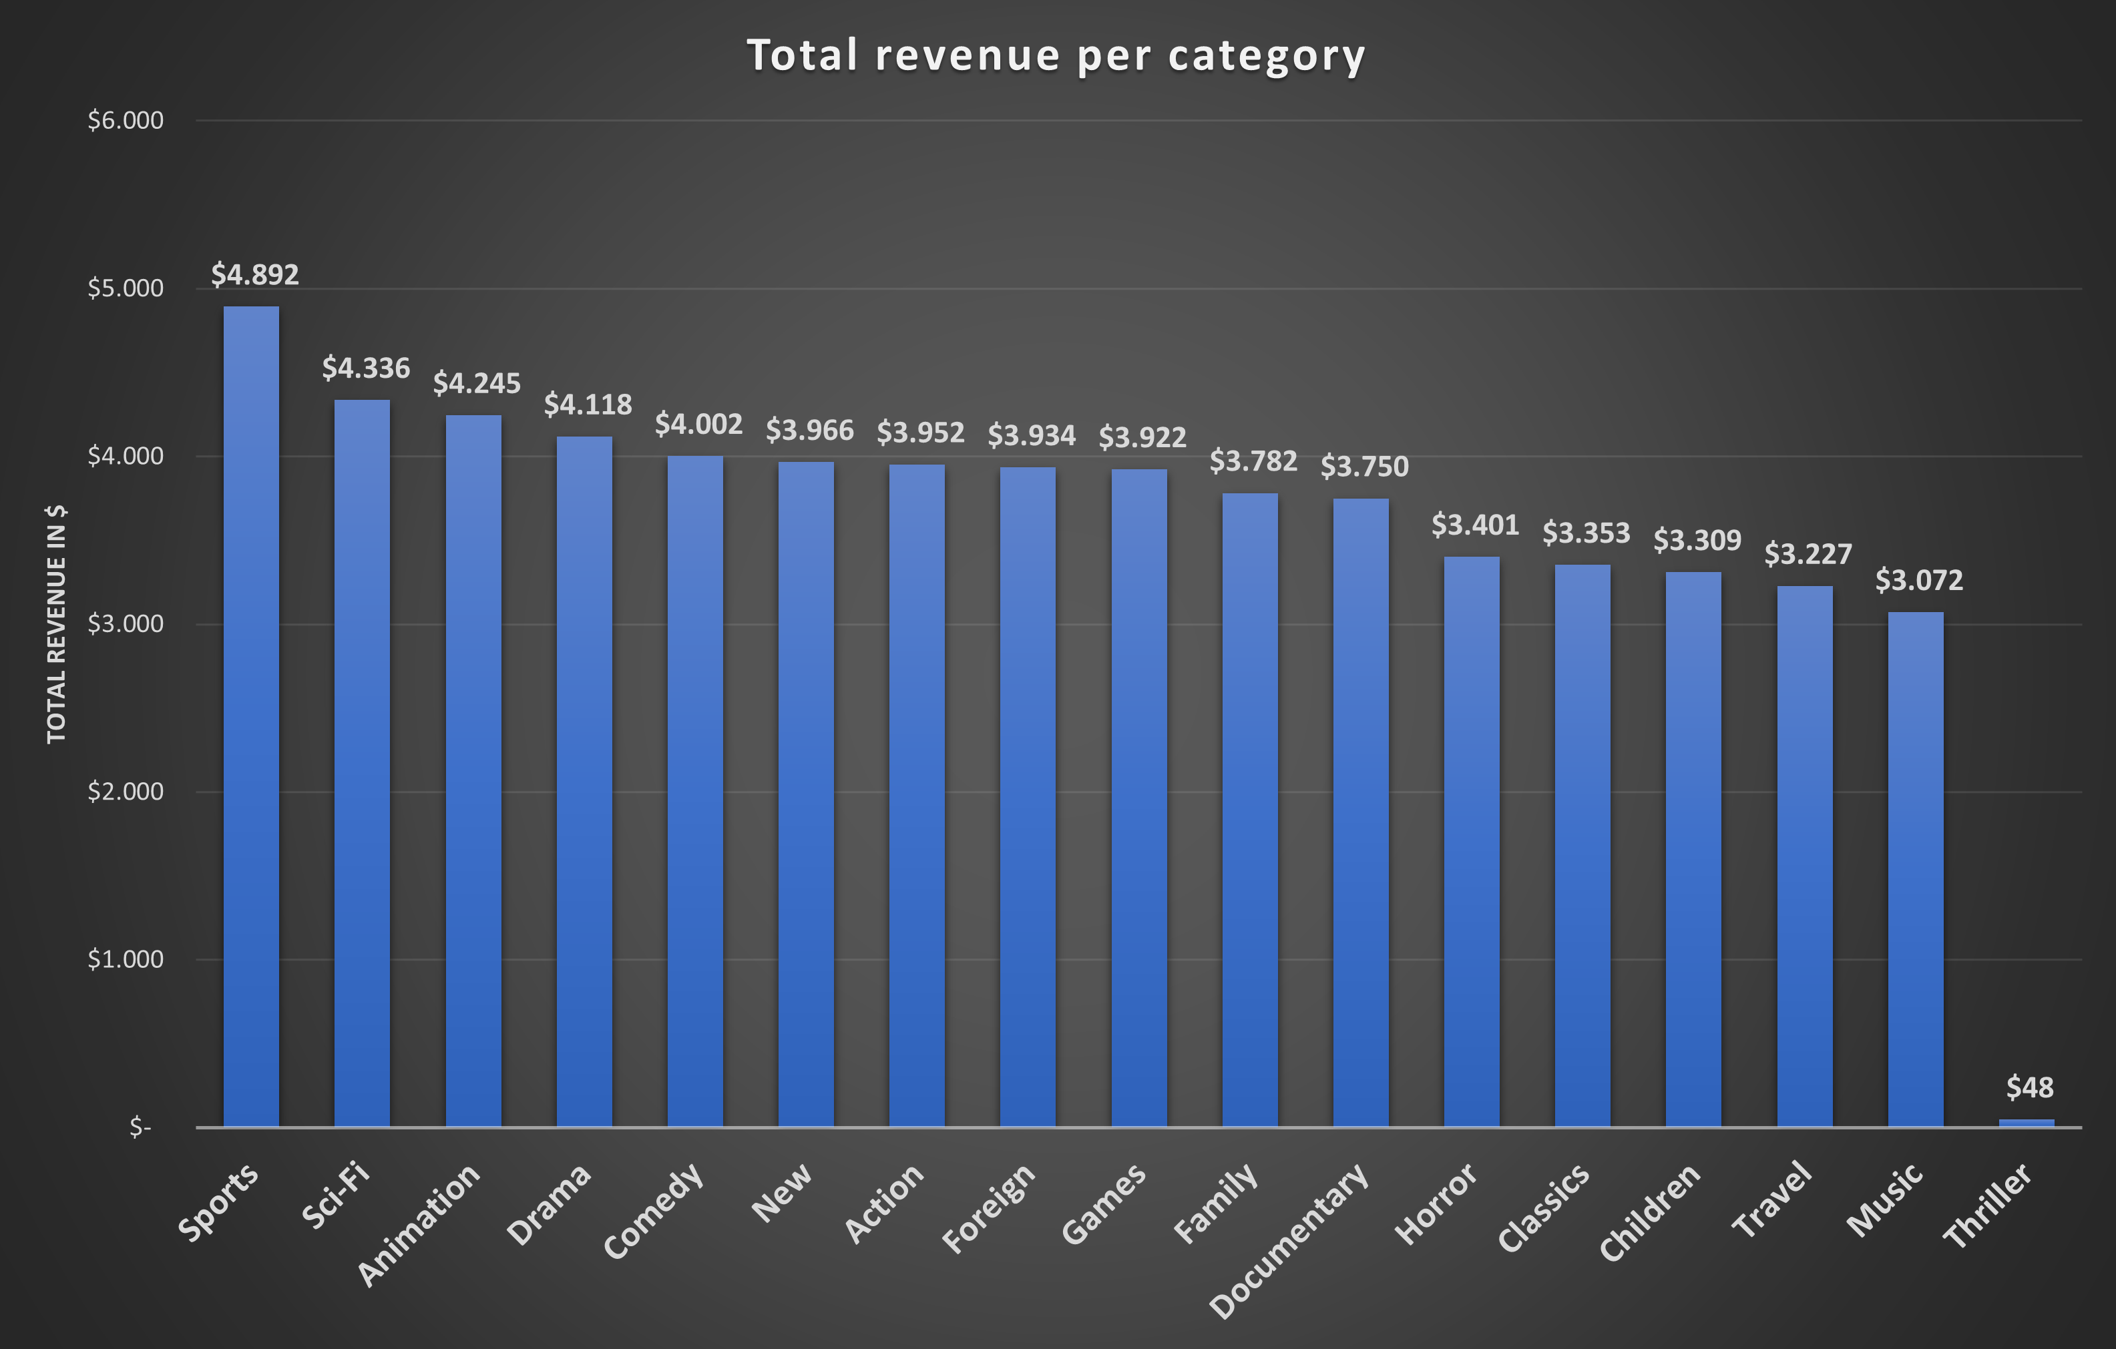
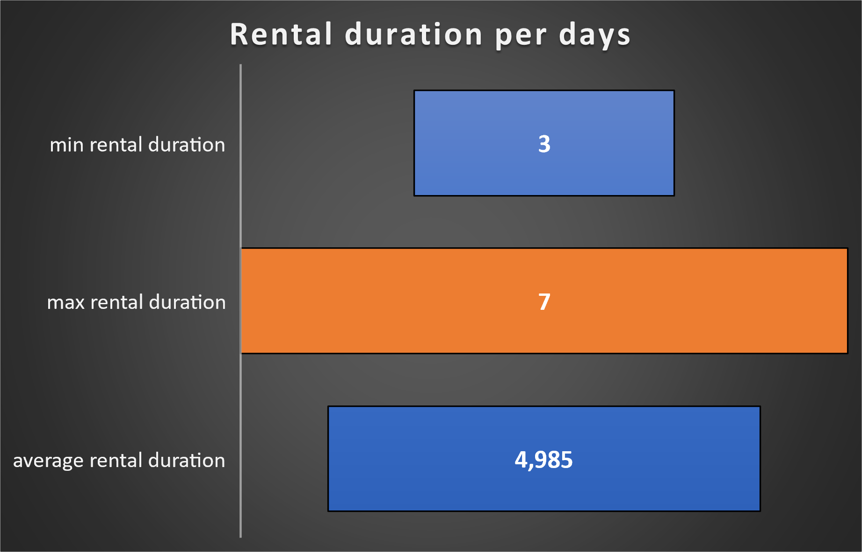
Total revenue per category and rental duration
Sports, Sci-Fi, Animation, Drama & Comedy are the category that generated the most revenue. Thriller is the least favorite category
On average, people rented our movies for more than 5 days, with a maximum of 7 days.

Slide 4
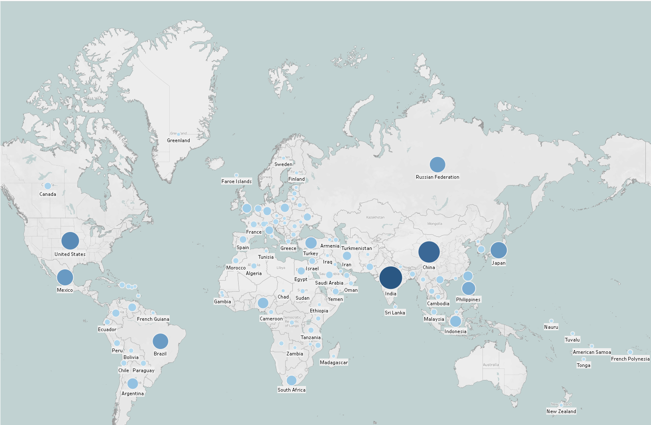
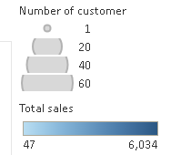
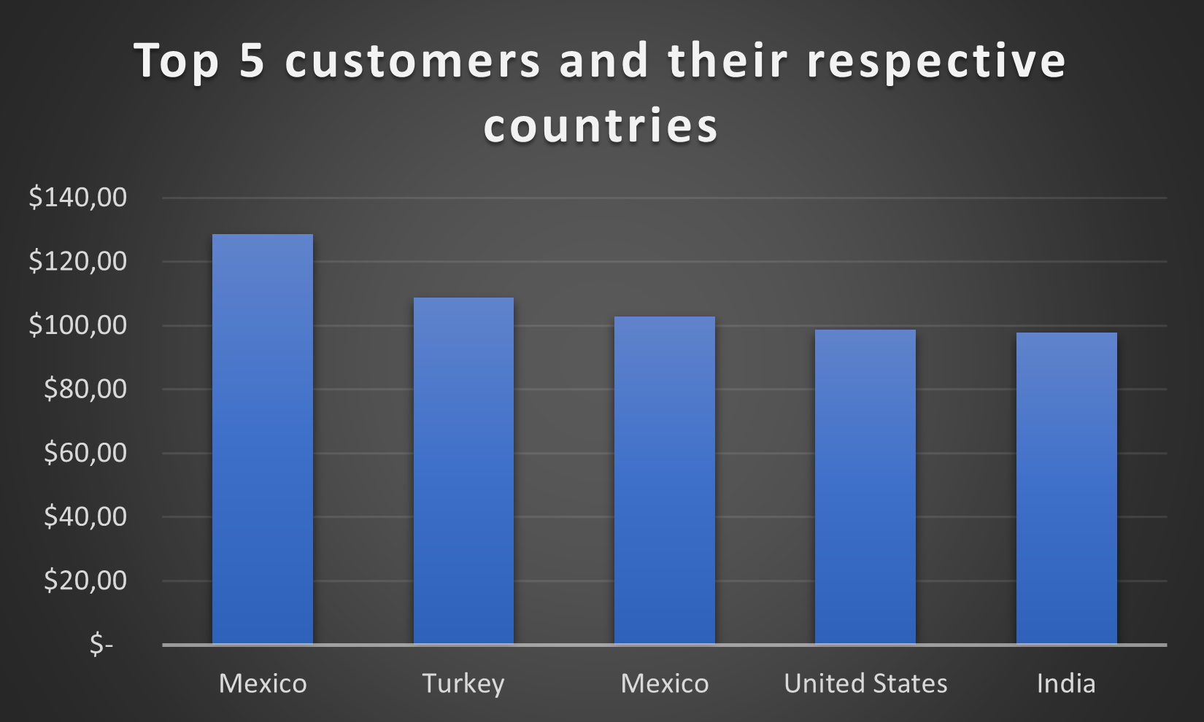
Number of customers and total sales per country
India, China and the USA are the countries with the most customers, and the ones that generate the highest revenue
Our high value customers are based mainly in Mexico, Turkey, the USA and India
Click here to visualize the map on Tableau

Slide 5
Conclusion and next steps
Conclusion
Next steps and advice
Most of our customers reside in India, China, USA and Japan, with Asia being our primary market
Consequently, the majority of our revenue is generated in these countries
The categories of movies also significantly influence the revenue potential for our planned online rental service
Entering the Asian market first would be the most straightforward approach due to the large customer base. With the brand already being relatively well-known, implementing a simple brand strategy would be easier.
Proposing a subscription model or different pricing based on the average rental days could bring beneficial results.
Lastly, offering discounts to our high-value customers could positively impact the brand's image.

Slide 6
Thank you. Feel free to ask any questions
Contact: salmi.oumaima@gmail.com

